Slide 1

Note: The data and information in this document is reflective of a hypothetical situation and client. This document is to be used for KPMG Virtual Internship purposes only.
Sprocket Central Pty Ltd
Data analytics approach

Slide 2
Note: The data and information in this document is reflective of a hypothetical situation and client. This document is to be used for KPMG Virtual Internship purposes only.
Agenda
Introduction
Data Exploration
Model Development
Interpretation

Slide 3
Note: The data and information in this document is reflective of a hypothetical situation and client. This document is to be used for KPMG Virtual Internship purposes only.
Introduction
Sprocket Central Pty Ltd.'s Customer Dataset Analysis
Sprocket Central Pty Ltd is a long-standing KPMG client whom specializes in high-quality bikes and accessible cycling accessories to riders. Their marketing team is looking to boost business by analyzing their existing customer dataset to determine customer trends and behavior.

Slide 4
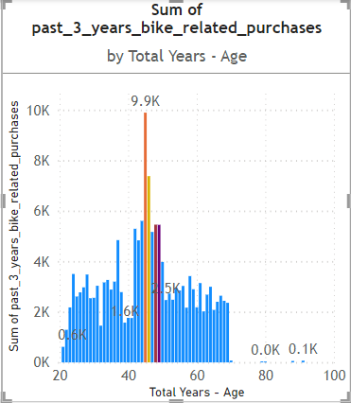
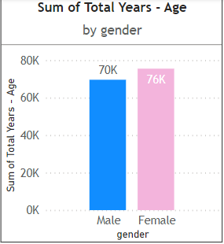
Note: The data and information in this document is reflective of a hypothetical situation and client. This document is to be used for KPMG Virtual Internship purposes only.
Data Exploration
Feature Engineering and Data Transformation:
Data shows age group 45 (male and female) both has high count in terms of bike purchased in last 3 years.
Female ratio of bike purchasers is slightly higher as compared to the male.
The target audience for our marketing and advertising should be inclined to provide focus on females than males.

Slide 5
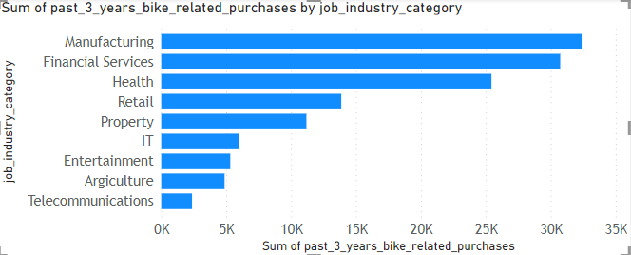
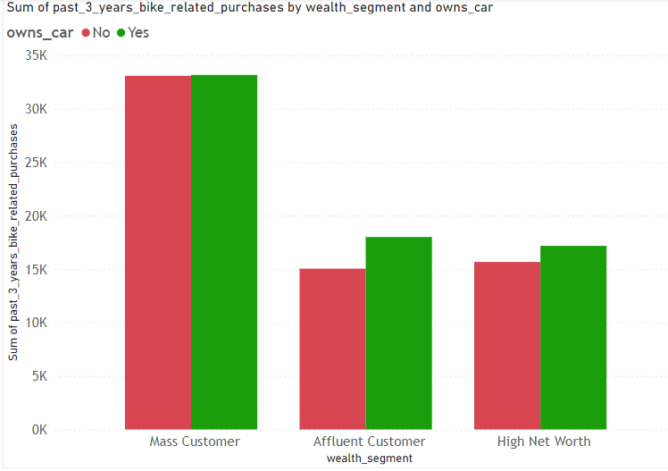
Note: The data and information in this document is reflective of a hypothetical situation and client. This document is to be used for KPMG Virtual Internship purposes only.
Data Exploration
Feature Engineering and Data Transformation:
Data shows that in past 3 years bike purchased audience is majorly from Manufacturing, Financial Services and Health industry
Mass customers from wealth segment has purchased maximum bikes in the last 3 years.

Slide 6
Note: The data and information in this document is reflective of a hypothetical situation and client. This document is to be used for KPMG Virtual Internship purposes only.
Model Development
CUSTOMER CLASSIFICATION – Targeting High Value Customers
The following are the high-value clients to target from the new list :
Aged between 40 – 50.
Most of the high value customers are female compared to male
Working in Financial Service, Manufacturing and Health.

Slide 7
Note: The data and information in this document is reflective of a hypothetical situation and client. This document is to be used for KPMG Virtual Internship purposes only.
Interpretation
HIGH-VALUE CUSTOMER SUMMARY TABLE
Customer ID | Bike Related Purchases for the last 3 years | Age | Job Industry | Wealth Segment | Owns Cars | State
1842 | 445 | 44 | Financial Services | Mass Customer | No | New South Wales
2001 | 168 | 44 | Manufacturing | Mass Customer | Yes | New South Wales
650 | 486 | 44 | Health | Mass Customer | No | New South Wales
3297 | 234 | 46 | Manufacturing | Mass Customer | No | Victoria
50 | 266 | 41 | Manufacturing | Mass Customer | Yes | New South Wales

Slide 8
Conclusion
Note: The data and information in this document is reflective of a hypothetical situation and client. This document is to be used for KPMG Virtual Internship purposes only.
Conclusion
Need to focus on building model for high value customer demographics to boost the business further.
Use these customer trends and behavior pattern for marketing campaign optimization.

